Slide 1

Galal Hossam
Mostafa Yehia
Abdullah Elsayed
Mohamed Kamal
EDISON
“Don’t waste your time for zero marks”

Slide 2


Wastewater Treatment

Slide 3

Contents:
1- Introduction
2- Stages of wastewater treatment
3- Anaerobic Digestion
4- UASB Reactor
5- Mathematical Models

Slide 4
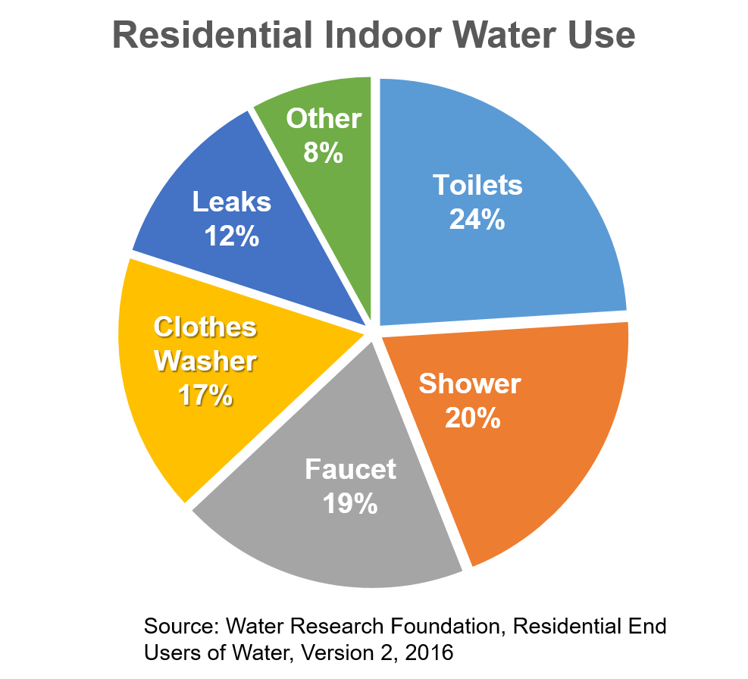
Introduction
Types of wastewater
Black water
Grey water
Toilets
Shower, clothes washer, etc.…

Slide 5

Water pollutants
Introduction
Sewage and domestic wastes
Heavy metals
Industrial effluents
Pesticides
Soap and detergent
Fertilizers

Slide 6
Introduction
Method of Wastewater Treatment
Biological
Chemical
Physical
Ways of collecting disposal wastewater:
Centralized system
Decentralized system

Slide 7

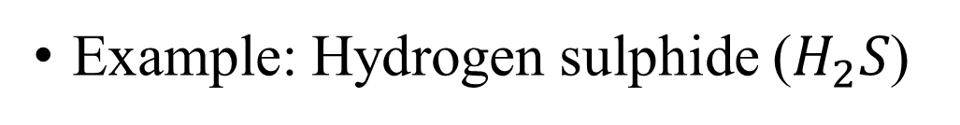
Stages of wastewater treatment
Odors Control :
During wastewater treatment there is a lot of harmful and dirty odors so we use chemical materials to reduce It by reactor or anything else.
Example: Hydrogen sulphide ($H_{2}S$)

Slide 8

Stages of wastewater treatment
Primary Treatment
Primary treatment involves basic processes to remove suspended particles wastes and reduce its bio-chemical oxygen demand (BOD)
Screening
Grit chamber
Sediment. tank

Slide 9
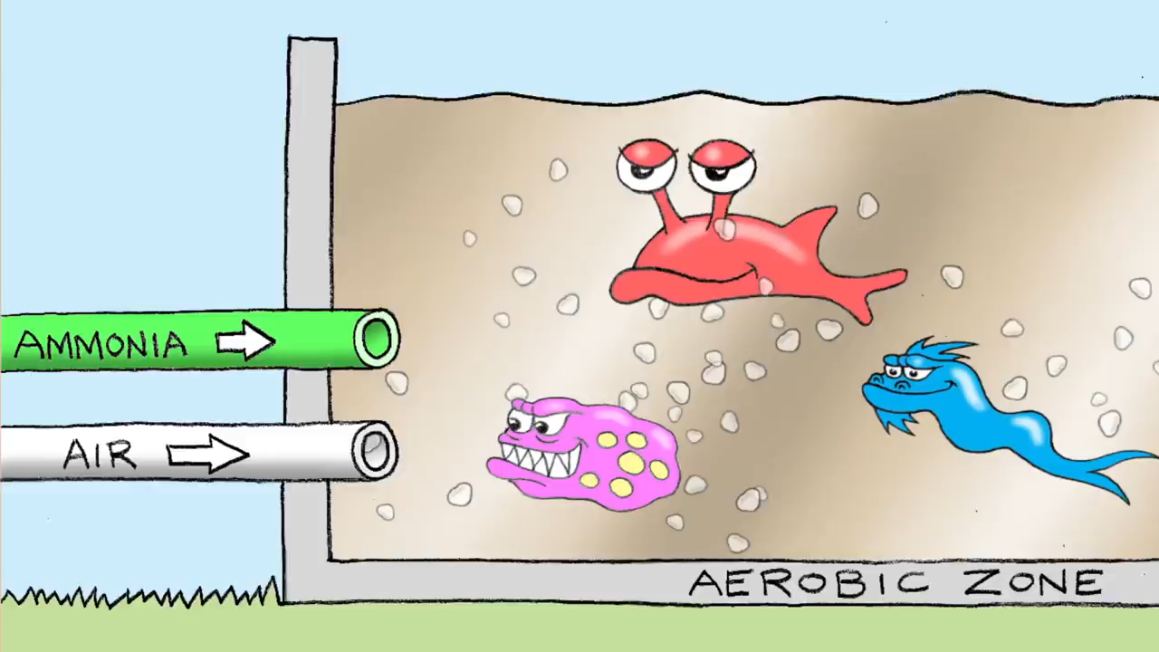
Stages of wastewater treatment
Secondary Treatment “Seed Sludge”
Aeration Tank
Secondary
Clarifier

Slide 10
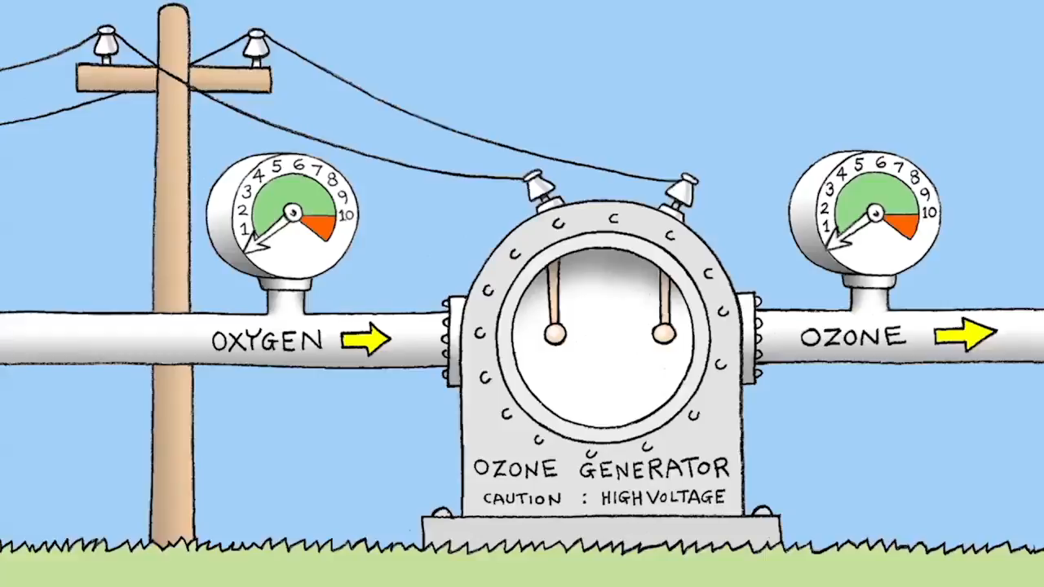
Stages of wastewater treatment
Tertiary Treatment
Filtration
Disinfection

Slide 11
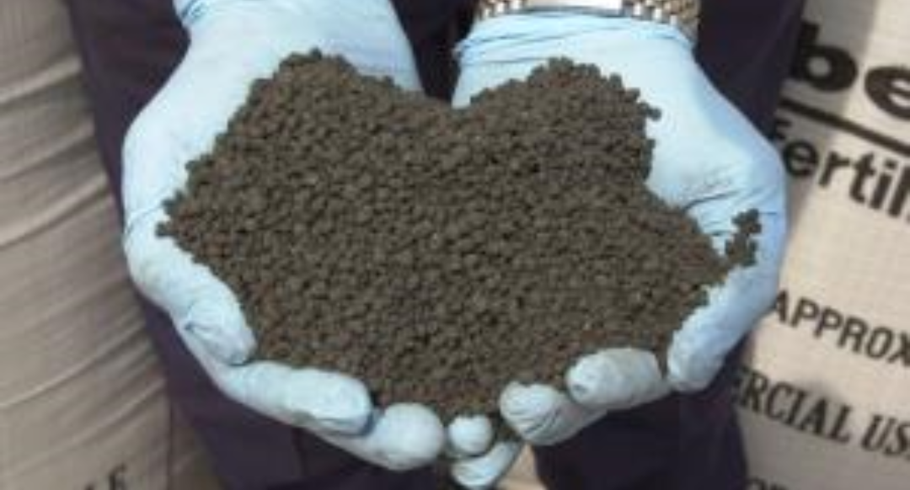
Stages of wastewater treatment
Sludge Treatment
After finishing the three main stages of treatment we collect all the sludges that comes out from the process
It is used in agriculture as fertilizers

Slide 12
Anaerobic Digestion:
Digestion in Wastewater Treatment
Organic polymers
Methane
Energy
Digestion in Humans
Organic polymers
Glucose
Energy

Slide 13

Anaerobic Digestion:
Digestion of Organic Polymers
Hydrolysis
Methanogenesis
Acidogenesis
Acetogenesis

Slide 14
Anaerobic Digestion:
Hydrolysis
Protein Hydrolysis
Proteins
Amino acid
Lipids Hydrolysis
Lipids and Fats
LCFAs
Carbohydrates and Polysaccharides
Carbohydrate
Simple Sugars

Slide 15
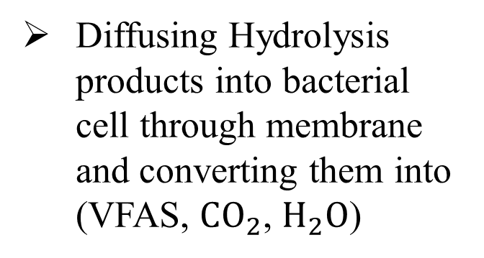
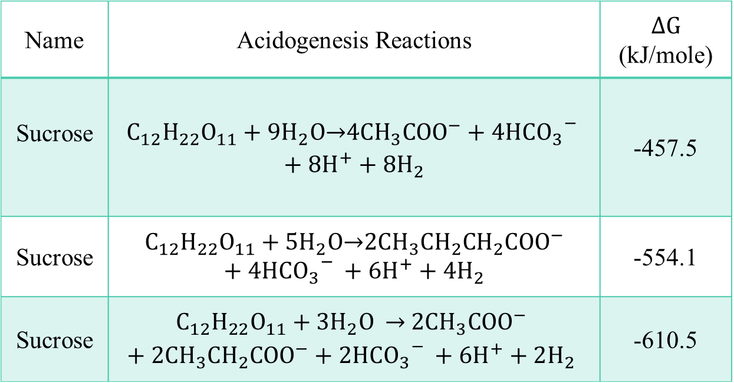
Anaerobic Digestion:
Acidogenesis
$∆G$ (kJ/mole) | Acidogenesis Reactions | Name
-457.5 | $$C_{12}H_{22}O_{11}+9H_{2}O\underset{→}{ }4CH_{3}COO^{−}+4HC{{O_{3}}^{−}}_{ }+8H^{+}+8H_{2}$$ | Sucrose
-554.1 | $$C_{12}H_{22}O_{11}+5H_{2}O\underset{→}{ }2CH_{3}CH_{2}CH_{2}COO^{−}+4HC{{O_{3}}^{−}}_{ }+6H^{+}+4H_{2}$$ | Sucrose
-610.5 | $$C_{12}H_{22}O_{11}+3H_{2}O \underset{→}{ } 2CH_{3}COO^{−}+2CH_{3}CH_{2}COO^{−}+2HC{{O_{3}}^{−}}_{ }+6H^{+}+2H_{2}$$ | Sucrose
Diffusing Hydrolysis products into bacterial cell through membrane and converting them into (VFAS, $CO_{2}$, $H_{2}O$)

Slide 16
Anaerobic Digestion:
Acetogenesis
Converting Acidogenesis products into (acetate, $CO_{2}$ and $H_{2}O$)
Types of Acetogenesis
Homo acetogenesis
Syntrophic Acetogenesis

Slide 17
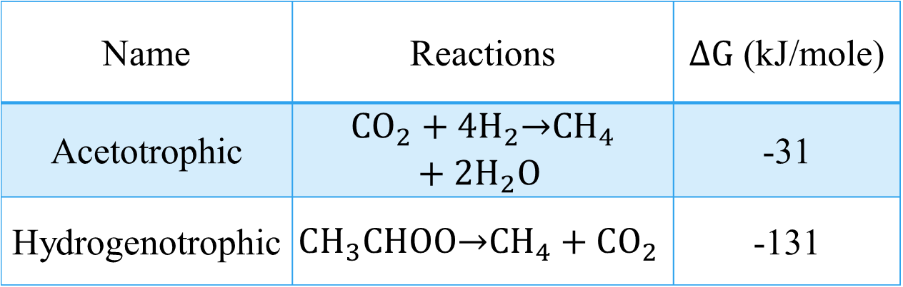
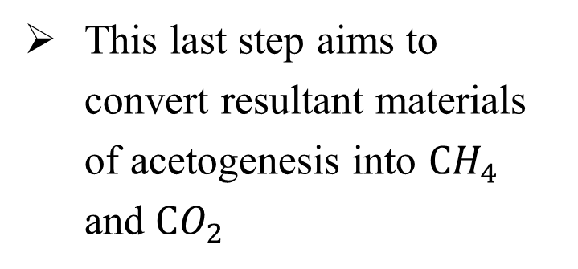
Anaerobic Digestion:
Methanogenesis
This last step aims to convert resultant materials of acetogenesis into $CH_{4}$ and $CO_{2}$
$∆G$ (kJ/mole) | Reactions | Name
-31 | $${CO}_{2}+4H_{2}\underset{→}{ }{CH}_{4}+2H_{2}O$$ | Acetotrophic
-131 | $$CH_{3}CHOO\underset{→}{ }CH_{4}+CO_{2}$$ | Hydrogenotrophic
Methanogenesis process
Acetotrophic Methanogenesis
Hydrogenotrophic Methanogenesis

Slide 18
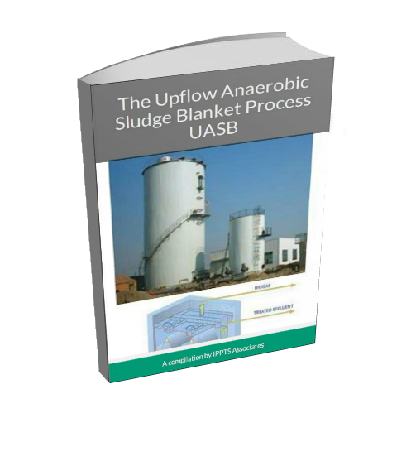
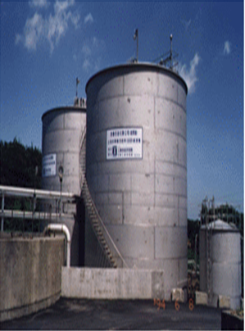
History of UASB Reactor
UASB Reactor
Before 1970s, we used to use aerobic reactor in wastewater treatment.
UASB reactor began to be used after increasing at the price of the raw oil and after Letting’s exploratory trip in 1979s.
The importance of granules formation.

Slide 19
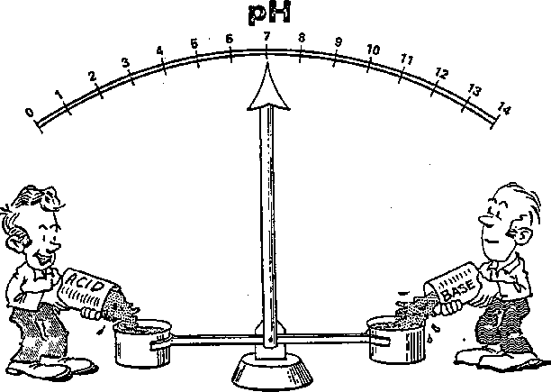
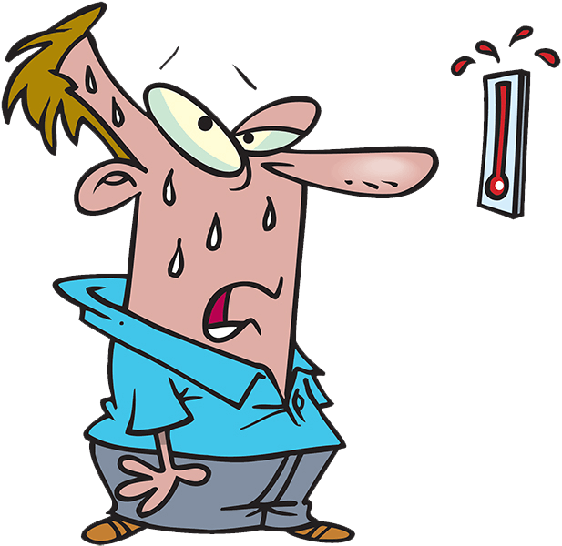
Factors that effect on the efficiency:
UASB Reactor
1- pH
There is three types of bacteria, each one has different value of pH
We have to save the real value of PH from 6 to 8
2- Temperature
The reactor can do its work at temperature (37 to 55 C )
Any change of this temperature can cause a lot of damage

Slide 20
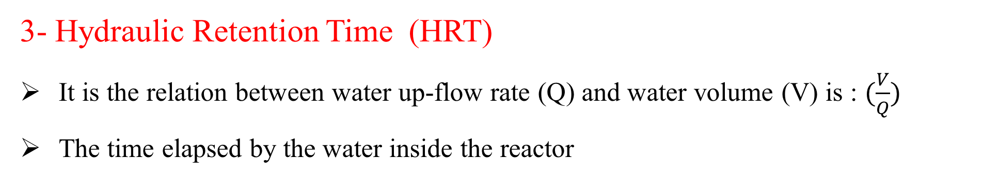
UASB Reactor
Factors that effect on the efficiency:
3- Hydraulic Retention Time (HRT)
It is the relation between water up-flow rate (Q) and water volume (V) is : $(\frac{V}{Q})$
The time elapsed by the water inside the reactor
4- Organic Loading Rate (OLR)
It is the amount of organic matter per day with respect to cross-section area of the reactor
The more OLR is in the reactor the faster performing of microorganisms, decreasing the amount of cod up-to (80%),and removing a lot of sludge

Slide 21
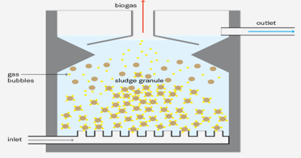
UASB Reactor
Factors that effect on the efficiency:
5- Substrate
It is a nutrients and dissolved material which feeds the reactor to increase the efficiency. Scientists used UASB reactor for more benefits like: (vegetable oil industry , methanol , phenol compounds …. etc.)
6- Sludge Inoculation

Slide 22
UASB Reactor
High reduction of BOD
Advantages
Can withstand high organic and hydraulic loading rates.
Low sludge
Biogas can be used for energy.

Slide 23
UASB Reactor
Treatment may be unstable with variable hydraulic and organic loads
Disadvantage
Long start-up time to work at full capacity
A constant source of electricity is required
Not all parts and materials may be locally available
Requires operation and maintenance by skilled personal; difficult to maintain proper hydraulic conditions
Effluent and sludge require further treatment and appropriate discharge

Slide 24
Mathematical Models

Slide 25
History and Background
Mathematical Models
Models’ main purpose is to modify us with full information about the thing we want to know – Processes – in a mathematical form – DE – that we can understand it or even simulate it at any engineering program “MATLAB program” and draw a graph which is the solution of the DE, and that we seek for from the beginning
Now we will mention quickly the first model invented by the scientists “Kinetics Models” about its type “Michaelis-menten Model, Monod Model and Contois Model”

Slide 26
kinetic Model
Mathematical Models
Kinetic Model
The Lag Phases
The exponential phase
The steady-state phase
The death phases

Slide 27
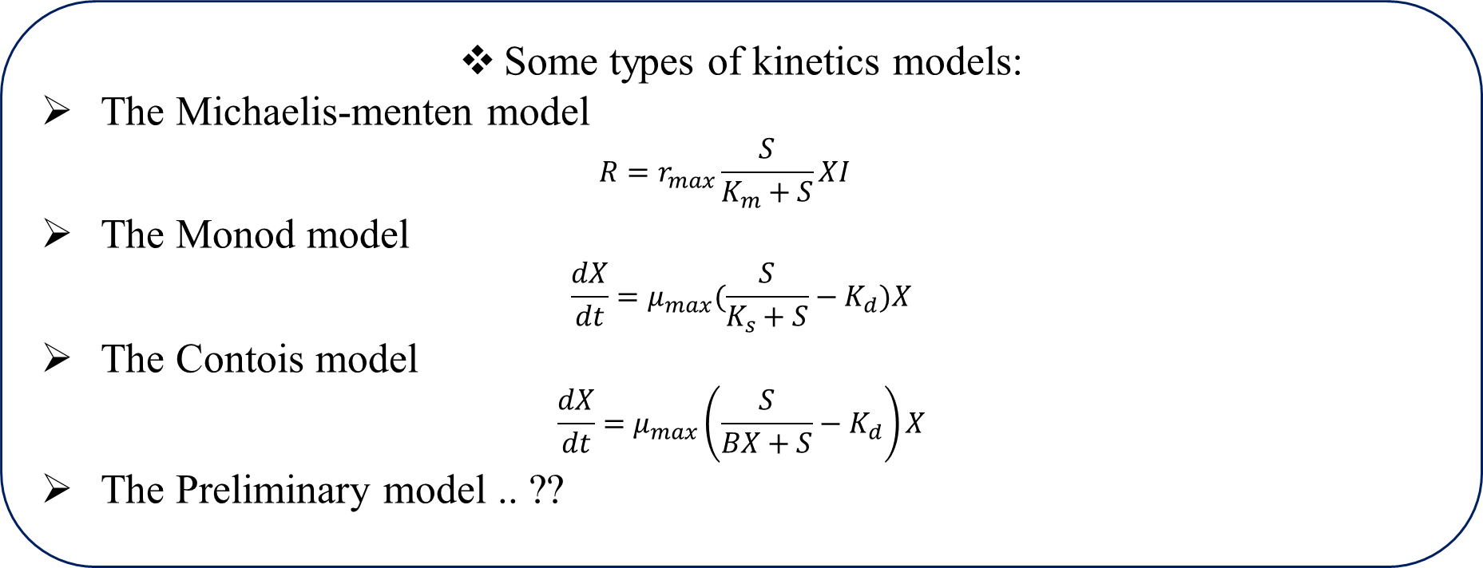
kinetics Models
Mathematical Models
Some types of kinetics models:
The Michaelis-menten model
$$R=r_{max}\frac{S}{K_{m}+S}XI$$
The Monod model
$$\frac{dX}{dt}=μ_{max}(\frac{S}{K_{s}+S}−K_{d})X$$
The Contois model
$$\frac{dX}{dt}=μ_{max}\left(\frac{S}{BX+S}−K_{d}\right)X$$
The Preliminary model .. ??

Slide 28

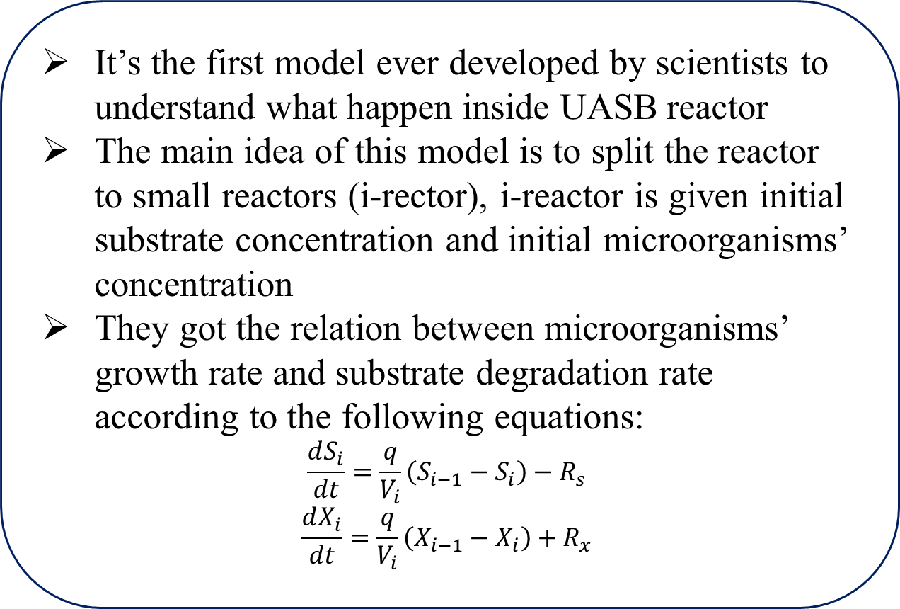
The Preliminary Model
Mathematical Models
It’s the first model ever developed by scientists to understand what happen inside UASB reactor
The main idea of this model is to split the reactor to small reactors (i-rector), i-reactor is given initial substrate concentration and initial microorganisms’ concentration
They got the relation between microorganisms’ growth rate and substrate degradation rate according to the following equations:
$$\frac{dS_{i}}{dt}=\frac{q}{V_{i}}\left(S_{i−1}−S_{i}\right)−R_{s}$$
$$\frac{dX_{i}}{dt}=\frac{q}{V_{i}}\left(X_{i−1}−X_{i}\right)+R_{x}$$

Slide 29
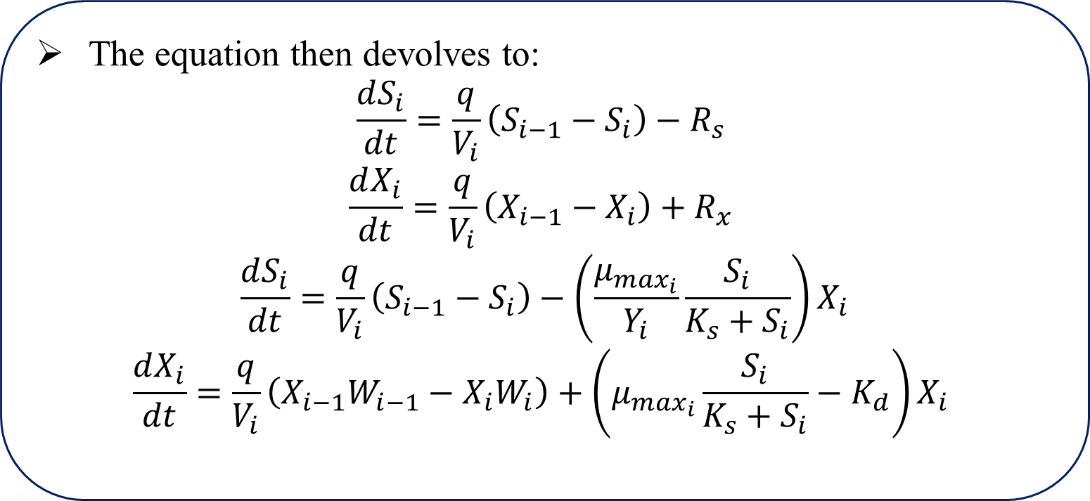
The Preliminary Model
Mathematical Models
The equation then devolves to:
$$\frac{dS_{i}}{dt}=\frac{q}{V_{i}}\left(S_{i−1}−S_{i}\right)−R_{s}$$
$$\frac{dX_{i}}{dt}=\frac{q}{V_{i}}\left(X_{i−1}−X_{i}\right)+R_{x}$$
$$\frac{dS_{i}}{dt}=\frac{q}{V_{i}}\left(S_{i−1}−S_{i}\right)−\left(\frac{μ_{\max_{i}}}{Y_{i}}\frac{S_{i}}{K_{s}+S_{i}}\right)X_{i}$$
$$\frac{dX_{i}}{dt}=\frac{q}{V_{i}}\left(X_{i−1}W_{i−1}−X_{i}W_{i}\right)+\left(μ_{\max_{i}}\frac{S_{i}}{K_{s}+S_{i}}−K_{d}\right)X_{i}$$

Slide 30
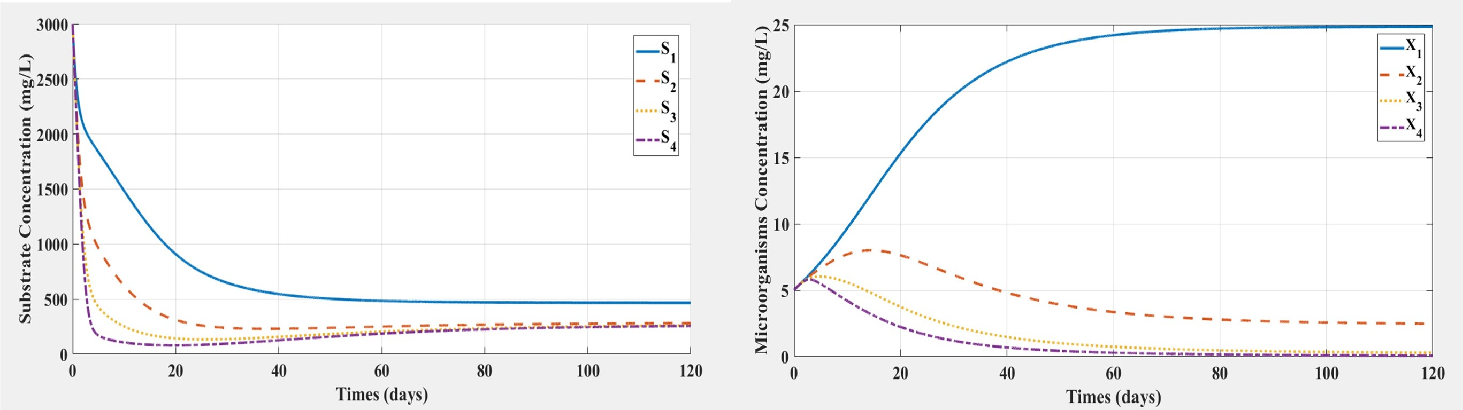
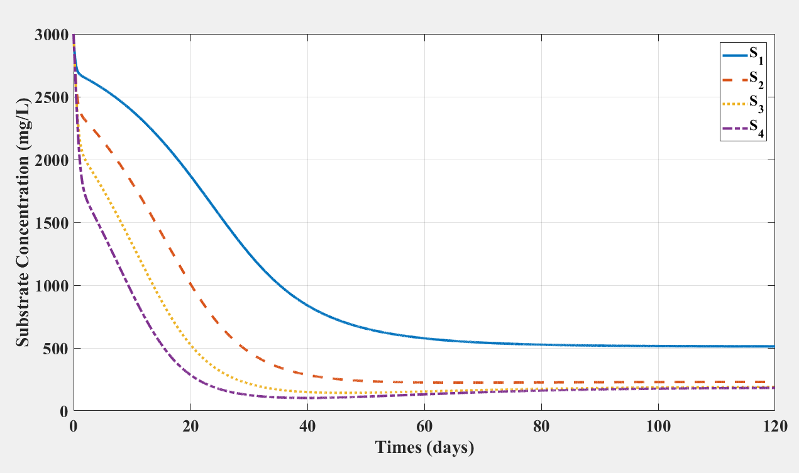
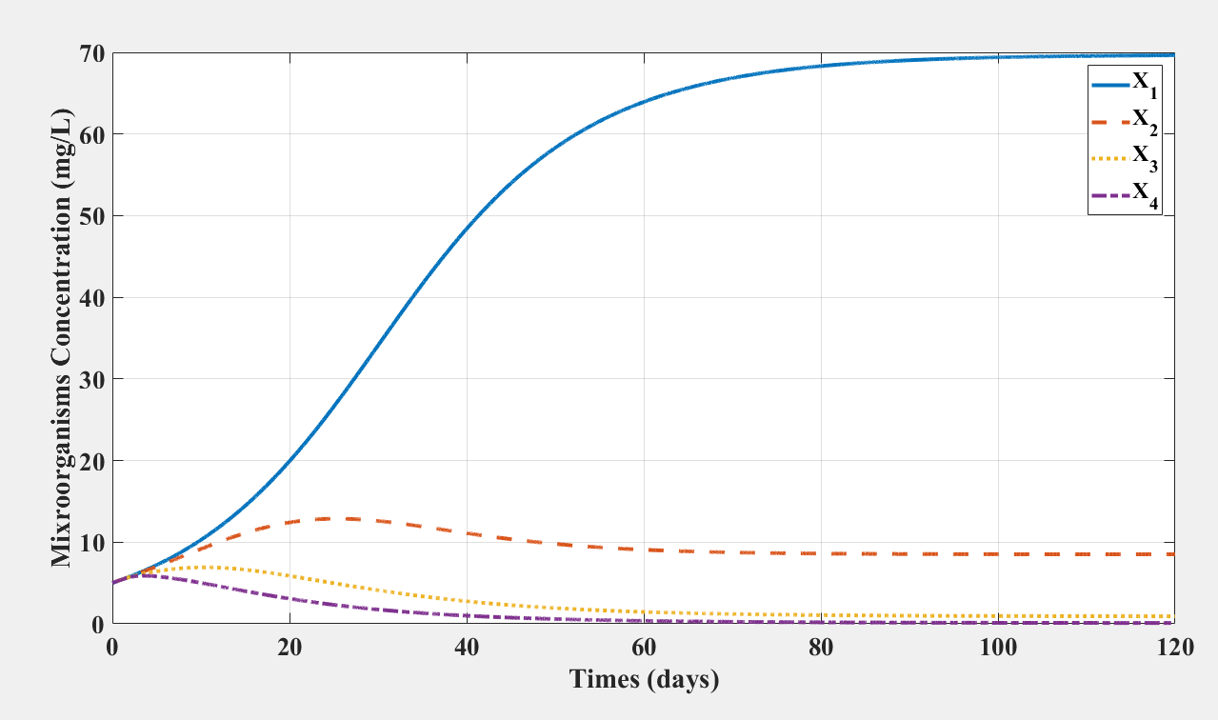
Results
Mathematical Models

Slide 31
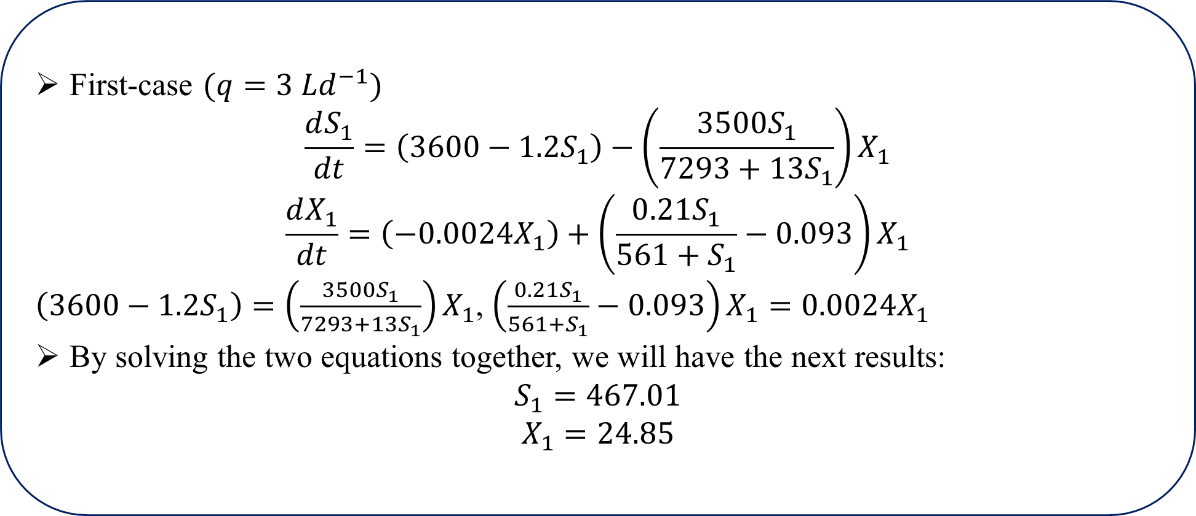
Steady-state analysis
Mathematical Models
First-case $(q=3 Ld^{−1})$
$$\frac{dS_{1}}{dt}=\left(3600−1.2S_{1}\right)−\left(\frac{3500S_{1}}{7293+{13S}_{1}}\right)X_{1}$$
$$\frac{dX_{1}}{dt}=\left(−0.0024X_{1}\right)+\left(\frac{0.21S_{1}}{561+S_{1}}−0.093\right)X_{1}$$
$\left(3600−1.2S_{1}\right)=\left(\frac{3500S_{1}}{7293+{13S}_{1}}\right)X_{1}$, $\left(\frac{0.21S_{1}}{561+S_{1}}−0.093\right)X_{1}=0.0024X_{1}$
By solving the two equations together, we will have the next results:
$$S_{1}=467.01$$
$$X_{1}=24.85$$
Zero
??

Slide 32

Steady-state analysis
Mathematical Models
Second-case $(q=9 Ld^{−1})$
$$\frac{dS_{1}}{dt}=\left(10800−3.6S_{1}\right)−\left(\frac{3500S_{1}}{7293+{13S}_{1}}\right)X_{1}$$
$$\frac{dX_{1}}{dt}=\left(−0.0072X_{1}\right)+\left(\frac{0.21S_{1}}{561+S_{1}}−0.093\right)X_{1}$$
$\left(10800−3.6S_{1}\right)=\left(\frac{3500S_{1}}{7293+{13S}_{1}}\right)X_{1}$, $\left(\frac{0.21S_{1}}{561+S_{1}}−0.093\right)X_{1}=0.0072X_{1}$
By solving the two equations together, we will have the next results:
$$S_{1}=511.95$$
$$X_{1}=69.72$$
Zero
??

Slide 33
Any Questions ??
Thank You

